Slide 1
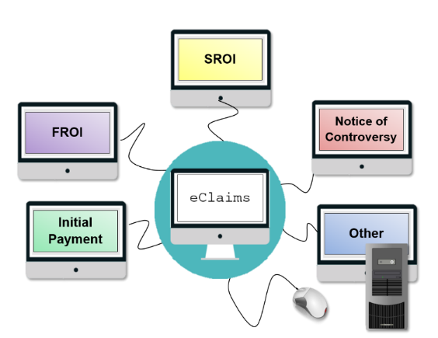

February 13, 2018
Payor Compliance
Subsequent Report of Injury
SROI Filings

Slide 2
Agenda:
Introductions/Welcome
Bulletin Notice
Review of Issues and Concerns regarding SROI filings
Subsequent Report of Injury – Employer Paid (SROI EP)
Subsequent Report of Injury – Initial Payment (SROI IP)
Subsequent Report of Injury – Payment Report (SROI PY)
Subsequent Report of Injury - Controversy (SROI 04)
Subsequent Report of Injury – Partial Denial (SROI PD)
Proper Filing
Invoice
Wrap Up/Questions

Slide 3
The Board issued a bulletin on April 22, 2016:
To assist payers to further develop proper compliance procedures, the Board has decided to change its schedule related to performance measures and penalty implementation. Penalties for timely first payment and timely SROI showing an initial payment have been temporarily placed on hold. This will allow carriers, self-insured employers, municipalities and Third Party Administrators the opportunity to continue to improve their overall performance.

Slide 4
Subsequent Report of Injury Employer Paid SROI EP

Slide 5
SROI EP:
The SROI EP should be filed with the Board when an injured worker is losing compensable time from work and the employer is paying wages.
It has been noticed that carriers are not filing the SROI EP when an employer is paying wages. The carrier files the SROI IP once the employer has stopped paying wages and the carrier is picking up the payments. This SROI IP is the first SROI the Board receives and is measured for timely filing and timely first payment and is often late.
The SROI EP is an automatic timely first payment.

Slide 6
SROI EP:
The SROI EP will be measured for timeliness of the filing using the 18/10 rule.
Effective 3/28/16 carriers can now file the SROI EP with the Agreement to Compensate Code of “W” without liability. There is no longer the need to file the SROI PD in this situation.

Slide 7
Subsequent Report of Injury Initial Payment SROI IP

Slide 8
SROI IP:
The SROI IP should be filed with the Board within the 18/10 rule when the initial payment is being made and the employer is not paying wages.
Claim Type Code: The claim type code on a SROI IP should always be an I - Indemnity or L- became Lost Time
If the claim type code is M- Medical Only, the Initial Date of Disability (DN0056) is not required on the SROI IP. When this occurs the Board will be using 18 days from the Date of Accident to determine timeliness. This will cause carriers to have late filings and late timely first payments.

Slide 9
SROI IP:
When a SROI IP is filed and not completed accurately, it leads to late filings.
Initial Date Disability Began/Current Date Disability Began – If the Initial Date Disability Began (DN0056) and the Initial Return to Work Date (DN0068) is less than or equal to 7 days and the injured worker loses further time from work, the carrier should enter a Current Date of Disability (DN0144), the Board would then measure 18 days from the Current Date of Disability (DN0144).

Slide 10
Subsequent Report of Injury Payment Report SROI PY

Slide 11
SROI PY:
The SROI PY should be used for a one time payment with no continuing compensation payments (CCP) made in accordance to the terms of an award payable within 10 days from the date the decision is duly filed, reporting payment of a Section 32, reporting payment of a SLU and payment of penalties.
SROI PY is being sent in as the initial SROI showing initial payment within 18/10 instead of the SROI IP.
The SROI PY will be measured for timeliness of initial payment and timeliness of filing if the SROI PY is showing a payment of indemnity and the Benefit Type Code (DN0085) is anything other than 030 Permanent Partial Schedule (SLU), 090 Permanent Partial Disfigurement (facial) or 5xx Lump Sum/Settlement.

Slide 12
Subsequent Report of Injury Controversy SROI 04

Slide 13
SROI 04:
The SROI 04 should be used when the right to compensation is controverted.
If a carrier files the SROI 04 and then files the SROI IP within the same quarter and prior to a hearing, the SROI IP is measured for timeliness of SROI showing initial payment and timely initial payment, the SROI 04 would not be measured.
If a carrier files the SROI 04, and then a SROI IP after the hearing has occurred, the SROI IP will not be measured through Payor Compliance, the SROI 04 would be measured. If the carrier files a good faith controversy and it is later denied, payment will be measured from the hearing date when payment was directed. If the judge finds a frivolous controversy was filed then a penalty under §25(2)(c) and a possible §114(a)(3) penalty may be assessed. At the discretion of the judge, all penalties may still be imposed.

Slide 14
Subsequent Report of Injury Partial Denial SROI PD

Slide 15
SROI PD:
A SROI PD should be filed with the Board if the injured worker has compensable lost time and the carrier is not making payment and has not controverted (FROI/SROI 04) the claim.
A SROI PD should only be used in very limited circumstances such as when the carrier has an IME indicating no disability, a medical report indicating no disability, a different site of injury than originally reported, when claimant fails to appear for carrier scheduled appointment per §13-a(3) or scheduled IME within the 7 day waiting period, where there is a medical report in the file that indicates the claimant will be out of work for seven days or less and there is no subsequent medical report of disability beyond the waiting period, in the rare instance where the medical evidence indicates a partial disability and the claimant has refused light duty, or in the rare instance where the claimant is losing time due to injuries on multiple claims and carrier is paying on one claim only, pending apportionment.

Slide 16
SROI PD:
It has been noticed that carriers are using the denial reason narrative on the SROI PD improperly. Some improper reasons being used are:
No lost time beyond seven days
No medical evidence of disability
No prima facie medical
Employer paying wages
If a SROI PD is filed prior to a SROI IP or any SROI showing the initial payment of indemnity, the SROI showing the initial payment is not measured as part of the Payor Compliance process. The SROI PD is reviewed manually, if the SROI PD is found to be used improperly then all penalties that would have been issued trough Payor Compliance will be assessed by an Administrative Decision.

Slide 17
Proper Filings

Slide 18
Proper Filings:
Measurements are made against the carrier of record (W-Code) at the end of the quarter.
If a filing is received in a case from the wrong carrier of record (W-Code) these forms are considered improper and are not measured. When the filing is made with the correct carrier of record (W-Code), the form is measured for timeliness.

Slide 19
Invoice

Slide 20
Invoice:
Invoices are only sent on penalties payable to the Board (§25(3)(e)).
If 30 days lapses from receipt of the proposed penalty notice and no request for review is received an invoice will be sent to the carrier advising of the penalty amount and the due date of payment.
Once the Board has reconciled all claims for that quarter in which a review was requested, AD was issued or Hearing held the Carrier will receive an invoice from the Board with the final penalty amount.
Payment of the penalty is expected 10 days from the invoice notice.

Slide 21
Invoice:
If withdrawing a penalty results in the carrier meeting the performance standard, the carrier will be notified that they have met the performance standard and that additional penalties are waived. No invoice will be sent.
Every proposed penalty notice and invoice have a penalty ID, that ID advises the Board of the quarter and category of the penalty in which to properly apply payment.
The penalty ID should be placed on all checks sent to the Board.
The Board would prefer one check for the entire payment for that quarter for that category.

Slide 22


February 13, 2018
Share your thoughts, questions and feedback with:
Denise Hughes, Monitoring Program Manager
Email: Monitoring@wcb.ny.gov
U
S
O
S
Q
E
T
I
N
Visit our website: http://www.wcb.ny.gov/content/main/Monitoring/Overview.jsp

