Slide 1
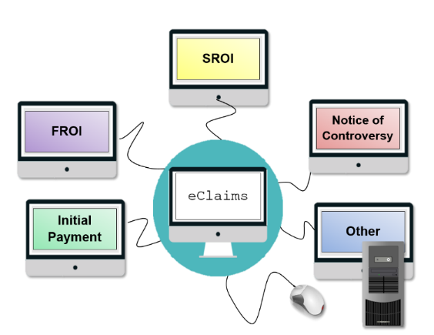

December 15, 2015
Payor Compliance
Request for Review

Slide 2
Agenda:
Introductions/Welcome
Address for Penalty Notice
Timelines for Issuance of Penalties
Request for Review Process
Hearing Process
Questions Received
Wrap Up/Questions

Slide 3
Address for Penalty Notice

Slide 4
Address for Penalty Notice:
The Board is requesting that every carrier (W code) send the carrier name, W code, full address along with the contact person’s name and e-mail address of where they would like the penalty letters to be sent. This is needed even if you do not wish to change the address the Board currently uses.
If the carrier would like a copy of the penalty letter sent to a Third Party Administrator, the carrier must send along with their information, the Third Party Administrators name, T code, full address along with the contact person’s name and e-mail address in which the penalty letter(s) should be sent.

Slide 5
Penalty Notice:
Please forward this information by e-mail to: monitorregistration@wcb.ny.gov. Please state "penalty letter" in subject line.
Please note that the addresses submitted will ONLY be used by the Board for the submission of the Payor Compliance penalty letters and will not affect any other mailings the Board currently sends. Carriers are also responsible to advise the Monitoring Unit when there is a change to a Third Party Administrator or an address change.

Slide 6
Timelines for Issuance of Penalties

Slide 7
December 15, 2015
Timeline for Issuance of Penalties:
Timeliness:
First report of injury filing (FROI)
Percentage:
Cases controverted
Initial payment of compensation
Notice of controversy
Subsequent Report Of Injury showing initial payment (SROI)
Notes:
Today, we will be focusing on:

Slide 8
Trial Period:
During the 6 month trial period the Monitoring Unit saw the following improvements:
Filing necessary data with the Board. When the trial period began, there were 11,970 claims with no filing or no indication of acceptance or denial of the claim. Today there are only 1,515 cases without a filing, an improvement of 87%.
Overall Timely First Report of Injury filings went from 65% in April to 71% in September.
Overall Payors meeting the performance standard of 70% of Timely First Report of Injury went from 55% in April to 67% in September.
Timely SROI filings and Timely Initial Payment measured from May to September:
Timely SROI from 31% timely to 35% timely
Timely First Payment (18/10) from 39% timely to 42% timely
Timely First Payment (18/10/10) from 39% timely to 47% timely

Slide 9
Monitoring Compliance
Penalties:
October 1st: System Goes Live
January 2016: 2015 4th quarter reports generated
January 2016: Late FROIs
July 2016: Late SROIs & Late 1st Payment
October 2016: Late Notice of Controversy
Reports
System Live

Slide 10
Performance Standard:
 |  | Performance Goals- Payor Compliance
 | 2015 | 2016 |  |  |  | 2017
 | 4th Qtr | 1st Qtr | 2nd Qtr | 3rd Qtr | 4th Qtr | 1st Qtr | 2nd Qtr | 3rd Qtr | 4th Qtr
Timely FROI | 70% | 75% | 80% | 85% | 85% | 85% | 85% | 85% | 85%
Timely SROI |  |  | 70% | 75% | 80% | 85% | 85% | 85% | 85%
Timely Controversy |  |  |  | 70% | 75% | 80% | 85% | 85% | 85%

Slide 11
Request for Review Process

Slide 12
Request for Review Process:
Reports will be posted to the Board’s web site at www.wcb.ny.gov using the Payor Compliance web application.
Reports will be posted on the15th of the following month, or next business day after the quarter being measured. Penalty notice are mailed the same day the reports are posted, but are postdated 2 days later.
If the Carrier is meeting the performance standard set for that quarter, the notice will indicate that no penalties will be imposed for that quarter.
The Carrier/TPA will have 30 days from the date of the penalty notice to review the cases that are considered late and request review.

Slide 13
Proposed Penalty Letter

Slide 14
Request for Review Process:
The Carrier/TPA will request review of the case(s) electronically on the Boards webpage using the Payor Compliance application.
The Carrier/TPA will need to state the reason for their request for review (text box) and will be able to upload and attach proof to their request.
After 30 days has lapsed, the Board will review the Carriers/TPA’s request for review and determine whether the penalty should be upheld or withdrawn.

Slide 15
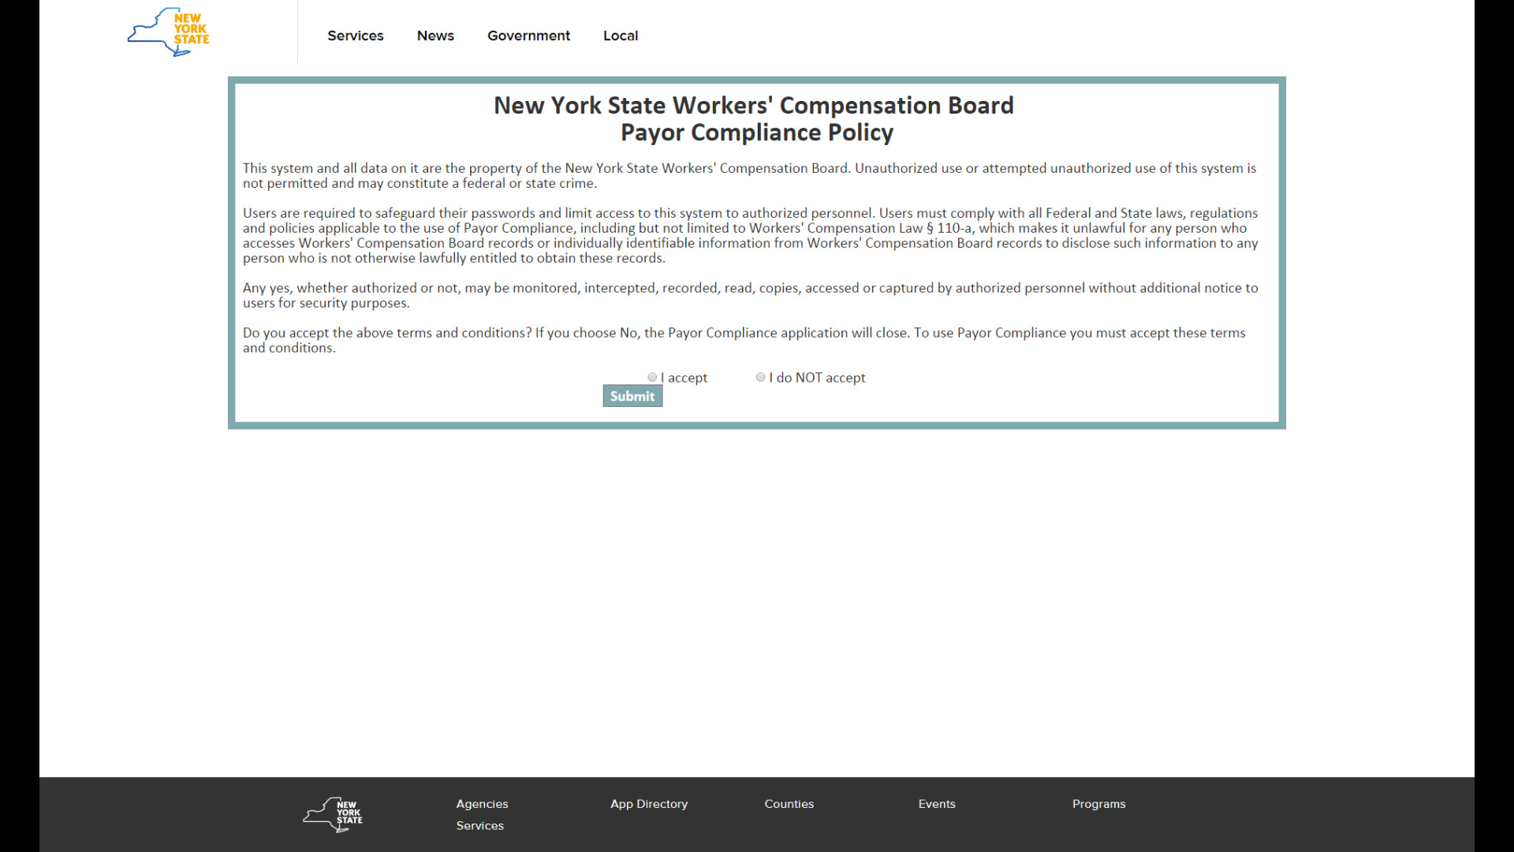
Log In

Slide 16
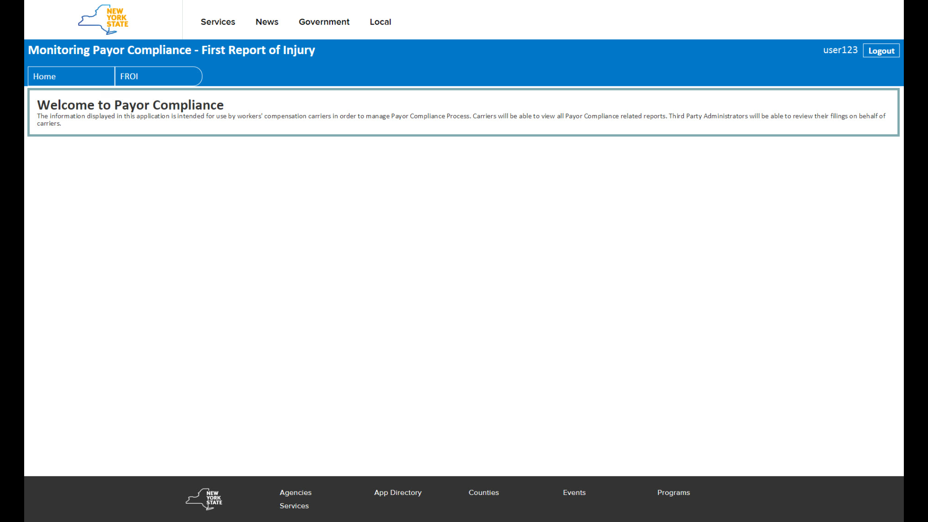
Main Screen

Slide 17
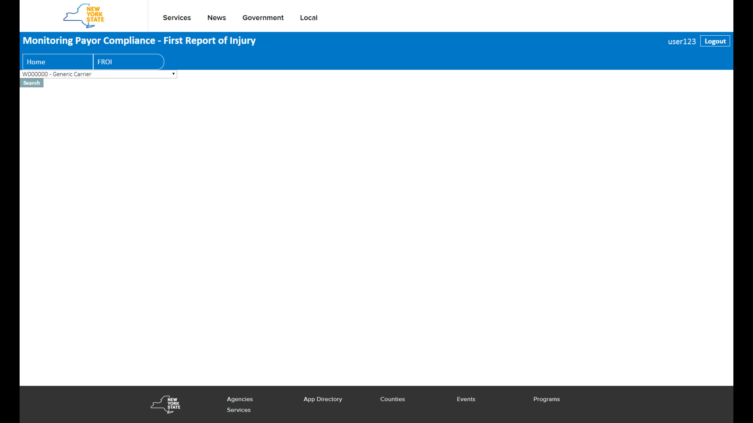
Screen Print
Carrier Listing

Slide 18
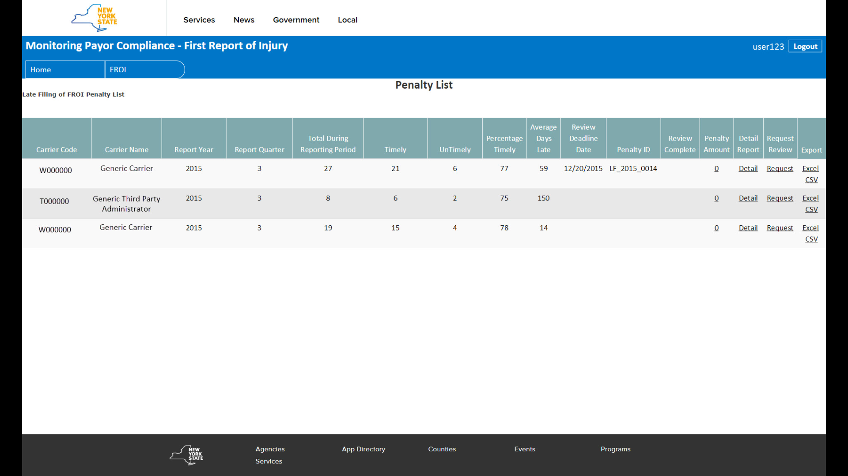
Summary Page

Slide 19
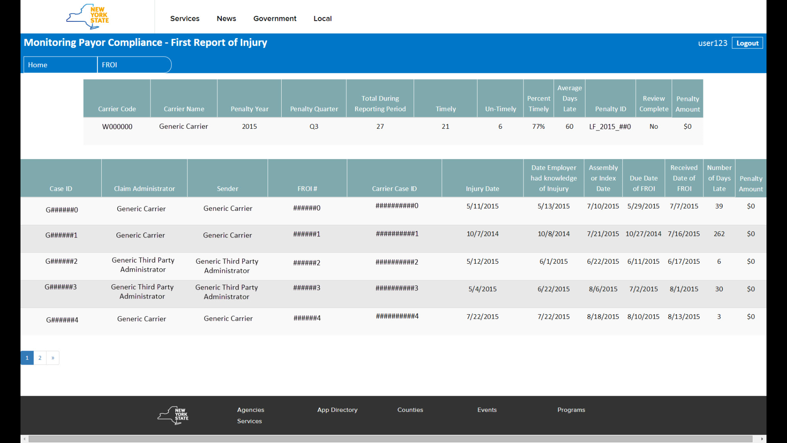
Detail Screen

Slide 20
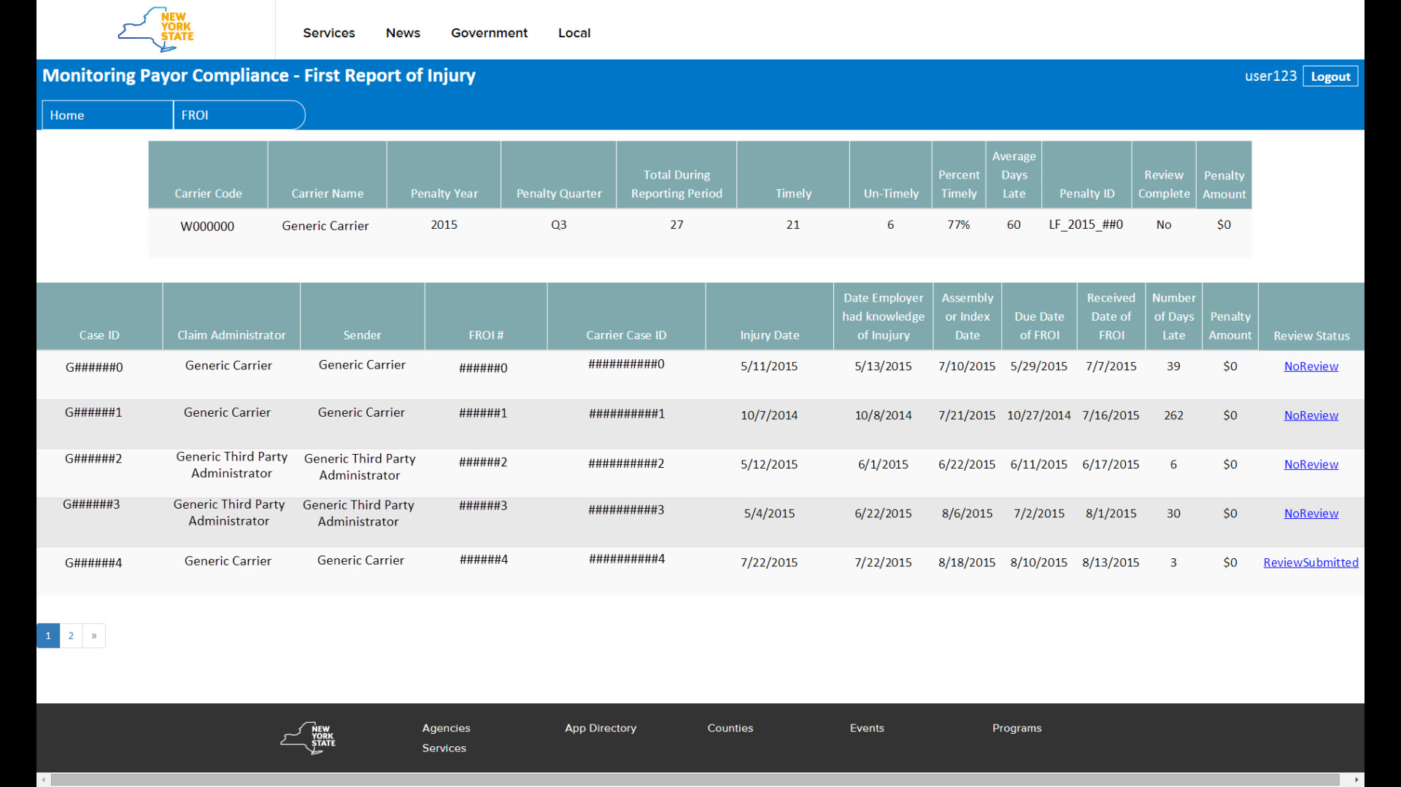
Request Review

Slide 21
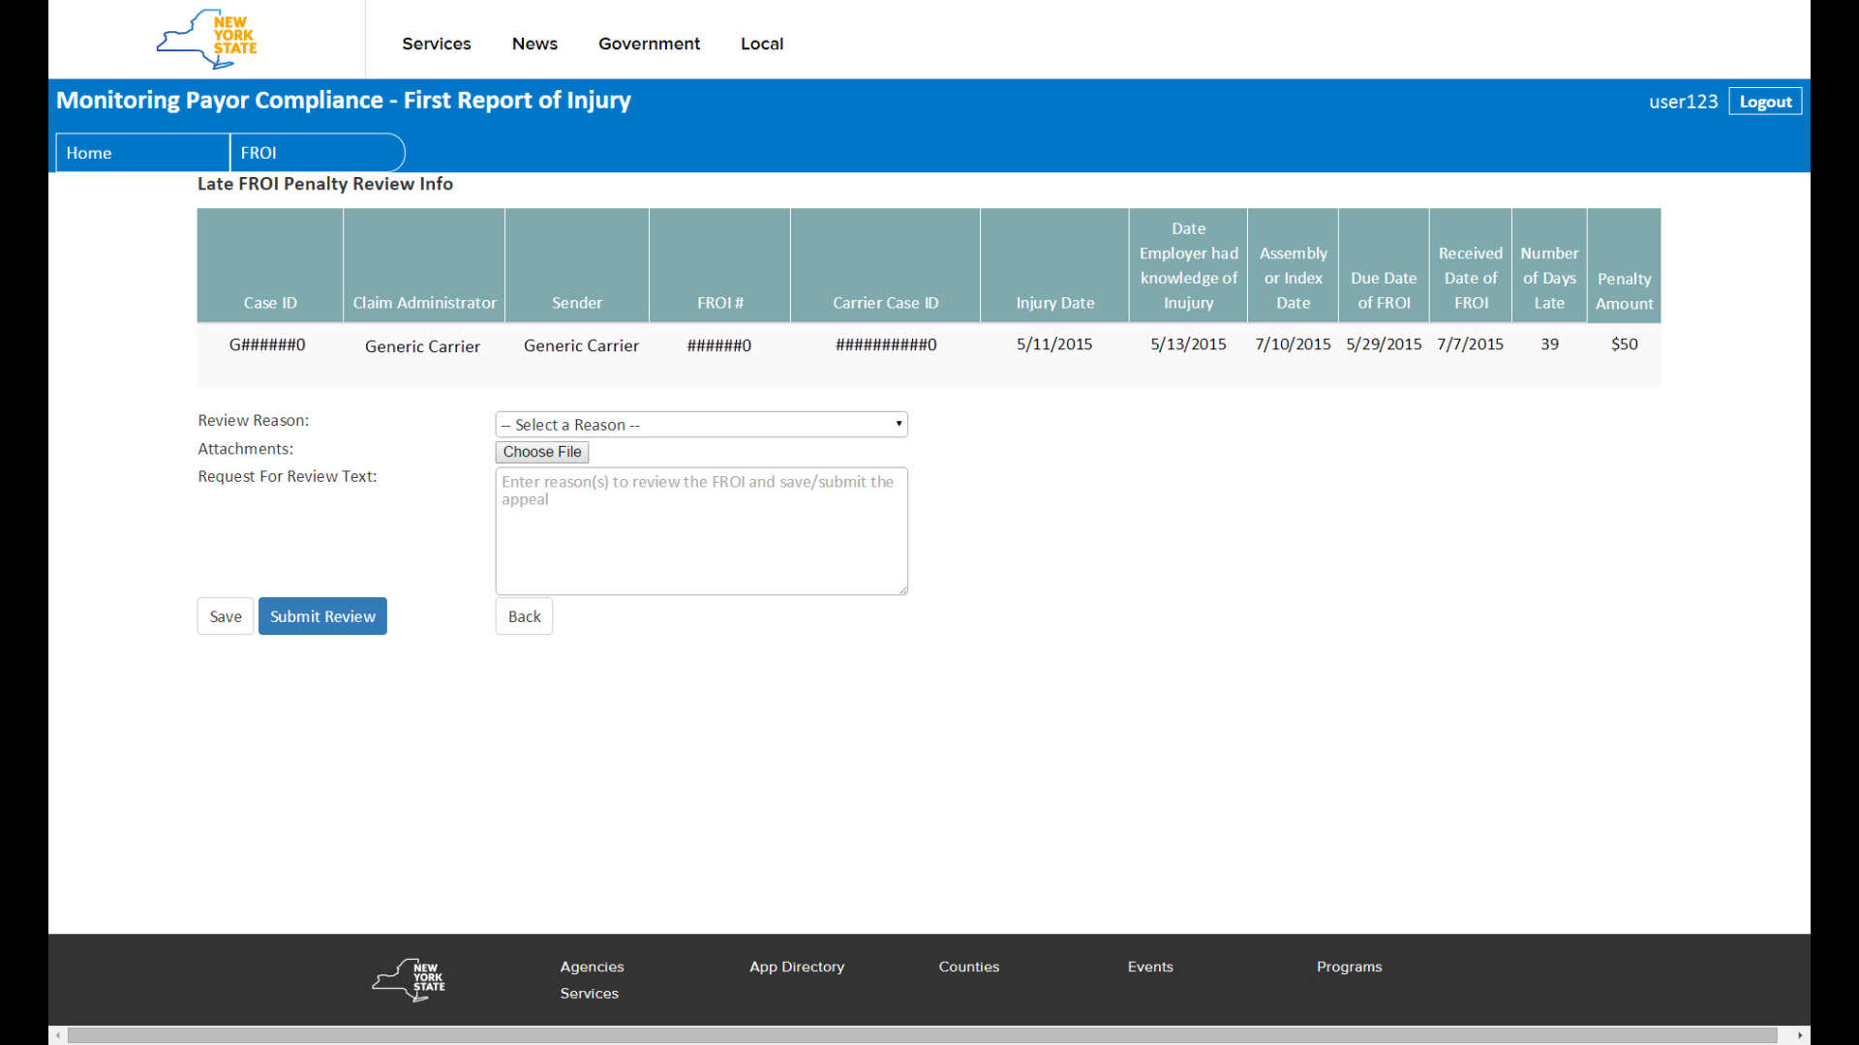
Review Reason and Submit

Slide 22
Penalty Withdrawn:
If the penalty is withdrawn, the Carrier/TPA will be able to see on the Boards webpage that their penalty amount and percentage of timely filings for that quarter has been updated with the new figures.
Once the Board has reconciled all claims in which review was requested, the Carrier/TPA will receive an invoice from the Board with the final penalty amount.
Payment of the penalty is expected 10 days from the invoice notice.
If withdrawing a penalty results in the carrier meeting the performance standard, the carrier will be notified that they have met the performance standard and that additional penalties are waived.

Slide 23
Penalty Upheld:
If the penalty is upheld, the Carrier/TPA will receive an Administrative Determination advising of so. The Carrier/TPA has 30 days to object to the Administrative Determination.
The Carrier/TPA will object to the Administrative Determination electronically on the Boards webpage using the Payor Compliance application.
The Carrier/TPA will need to state the reason for their objection (text box) and will be able to upload and attach proof to their request.
Objections to this decision made without reasonable grounds are subject to additional penalties under WCL §114-a(3).

Slide 24
Hearing Process:
If the Carrier/TPA objects to the Administrative Determination, they will receive a hearing notice with the date and time of their hearing.
The sole issue addressed at such hearings will be the penalty issue.
Hearings will be set by carrier, not by claim, to address all outstanding penalties upheld for that quarter.

Slide 25
Access to Request Review
Carrier/TPA’s assigned an individual as the “administrator” for eClaims Inquiry when they set up their initial registration. The “administrator” has the ability to add/remove users. In order to request review the “administrator” needs to verify that individual has been added as a user.
Below is the link that is used by the administrator to add or remove users.
http://www.wcb.ny.gov/content/ebiz/eclaims/Registration/AdminResponsibilities.jsp

Slide 26
Questions Received

Slide 27
Questions:
Question:
The FROI is due prior to the claim being reported by the Employer to the Carrier and/or being received by the Carrier?
Answer:
The penalty stands as Section 54(2) of the Workers Compensation Law states notice and knowledge to the employer is notice and knowledge to the carrier. It is in the best interest of the carrier to educate their employers regarding timely notice. The Board regularly speaks with employers and has and will continue to advise them of their obligation to timely notify carriers of an injury.
The Board is tracking both the employer knowledge date along with the claims administrator knowledge date. Initially no penalties will be imposed against the employer. After an initial time period, all penalties available under the law will be considered including when appropriate, WCL 110 (4) against the employer.

Slide 28
Questions:
Question:
What if the Payor notices that incorrect data was submitted to the Board after a penalty has been issued that changes the timelines and makes the claim timely.
Answer:
The Payor should request review of the penalty and send the FROI 02 making the correction. The Request for Review will be processed and the penalty will be withdrawn. The Payor’s should send all corrections (FROI 02) prior to the end of the quarter so that the data measured is accurate.
Question:
What if the Payor notices that incorrect data was submitted to the Board which would not change the timeliness of the FROI.
Answer:
The Payor should send the FROI 02 making the correction as soon as possible. The Payor should not request review of the penalty.

Slide 29


December 15, 2015
Share your thoughts, questions and feedback with:
Denise Hughes, Monitoring Program Manager
Email: Monitoring@wcb.ny.gov
U
S
O
S
Q
E
T
I
N
Visit our website: http://www.wcb.ny.gov/content/main/Monitoring/Overview.jsp

