Slide 1
Monitoring & Compliance
Timeliness of Controversy

Slide 2
Agenda
Introductions/Welcome
How We Are Measuring
Timeliness of Controversy
Monitoring Compliance
Timeliness of Controversy
Controversy
Measured or Not
Request for Review
Invoice Process
Controversy Reports
Wrap-Up/Questions

Slide 3
Payor Compliance
Measuring timeliness of Controversy (FROI/SROI 04).
The Board will begin to measure Controversy transactions received in the third quarter of 2017 on claims with a date of accident of 5/23/14 or after.
Penalties will be issued in October of 2017.

Slide 4
How We Are Measuring
Timeliness of Controversy

Slide 5
How We Are Measuring
Timeliness of Controversy
Enforcement of the 18/10 Day Rule defined in NYCRR Section 300.22 : “On or before the 18th day after the disability event OR within 10 days after the employer has knowledge of the disability event, whichever period is greater, the carrier, Special Fund, self-insured employer or TPA shall file electronically a Notice of Controversy(FROI-04/SROI-04) with the Board”.
"Disability event" means any accident, including death resulting therefrom, occurring in the course of employment or any alleged accident, including death resulting therefrom, that results in personal injury which has caused or will cause a loss of time from regular duties of one day beyond the working day or shift on which the accident or alleged accident occurred, or which has required or will require medical treatment beyond ordinary first aid or more than two treatments by a person rendering first aid; or any disease or alleged disease, including death resulting therefrom, claimed to have been caused by the nature of the employment and contracted therein.

Slide 6
How We Are Measuring
Timeliness of Controversy
The Board will begin to measure Timeliness of Controversy only on lost time claims. Therefore, timelines will be measured from 18 days from date of accident, 10 days from date employer had knowledge of Injury, or 10 days from Initial date of disability, whichever period is greater.
The Board will only be measuring the filings made against the primary insurer of record at the time of the filing.

Slide 7
Monitoring Compliance
Timeliness of Controversy

Slide 8
Monitoring Compliance
Penalties for Untimely Controversy
Since the Board is only measuring lost time claims, the Board will also include 10 days from Initial Date of Disability
WCL §25 (3)(e)
If the carrier or employer fails to file a notice within 18 days of disability event or 10 days after employer knowledge, the Board may impose a $50 penalty (18/10/10).
WCL §25 (2)(a)
When a carrier fails to file a notice of controversy or begin payment within the prescribed period or within 10 days of claims administrator knowledge of injury(whichever period is greater), the Board may impose a $300 penalty payable to the claimant in addition to any other penalty (18/10/10/10).

Slide 9
Monitoring Compliance
Determination of Dates Used for Measurements
Employer Knowledge Date
To Determine Employer Knowledge Date — the Board will use the earliest date of Date Employer Had Knowledge of the Injury (DN0040), Date Employer Had Knowledge of Disability (DN0281), Assembly Notice Date, or Indexing Notice Date.
Claim Administrator Knowledge Date
To determine Claim Administrator Knowledge Date of Injury the Board will use the earliest date of Date Claim Administrator Had Knowledge of the Injury (DN0041), Assembly Notice Date, or Indexing Notice Date.

Slide 10
Monitoring Compliance
Penalty for Late Controversy
Performance Standards
The penalty under §25(3)(e) will not be imposed as long as a carrier meets the below performance standards set per quarter. If the performance standard is met per quarter your §25(3)(e) penalty will be waived.
3rd Quarter 2017 - 70%
4th Quarter 2017 - 75%
1st Quarter 2018 - 80%
2nd Quarter 2018 - 85%

Slide 11
Performance Standards
2015 | 2016 |  |  |  | 2017 |  |  |  | 2018
4th Qtr | 1st Qtr | 2nd Qtr | 3rd Qtr | 4th Qtr | 1st Qtr | 2nd Qtr | 3rd Qtr | 4th Qtr | 1st Qtr
Timely FROI | 70% | 75% | 80% | 85% | 85% | 85% | 85% | 85% | 85% | 85%
Timely SROI |  |  |  |  |  | 70% | 75% | 80% | 85% | 85%
Timely Controversy |  |  |  |  |  |  |  | 70% | 75% | 80%
Quarter Penalized
Quarter Not Penalized

Slide 12
Controversy
Measured or Not

Slide 13
Notice of Controversy (FROI/SROI 04)
If the first transaction received is the FROI 04, this transaction will be used to measure Timely First Report of Injury as well as the two Controversy measurements previously discussed.
If a Notice of Controversy is received, and then a SROI showing payment of indemnity is received prior to a hearing, the Notice of Controversy is measured for timeliness of the filing under §25(3)(e) and §25(2)(a). The SROI will also be measured for timely SROI showing initial payment, timely first payment and timely installment.

Slide 14
Notice of Controversy (FROI/SROI 04)
If the controversy transaction shows no lost time, but a subsequent transaction is received showing lost time (1 day), the controversy is measured regardless of the quarter the transaction was made using the received date of the controversy.
If the controversy has a type of loss code of 02- Occupational Disease or 03- Cumulative Injury, the transaction is excluded from measurement.
If the type of loss code is subsequently changed to 01- Traumatic Injury the initial controversy is measured.

Slide 15
Notice of Controversy (FROI/SROI 04)
If the controversy is raising solely coverage issues 3a-3g, the transaction is excluded from measurement.
If a subsequent FROI/SROI 02 is filed updating the controversy reasons to include issues other than 3a-3g, the initial controversy will be measured.

Slide 16
Request for Review
Implementation of 2017 Reform Changes

Slide 17
Request for Review
§25(3)(e), §25(2)(a) and §25(1)(e) Penalty Process
Reports are posted using the Payor Compliance web application on the Board’s web site at www.wcb.ny.gov on the 15th of the month, or next business day, after the quarter being measured.
“Proposed Penalty” letters or “Met Performance” letters are mailed the same day the reports are posted, but are postdated 2 days later.
The Carrier/TPA will have 30 days from the date of the proposed penalty notice to review the cases that are considered late and request review.

Slide 18
Request for Review
§25(3)(e), §25(2)(a) and §25(1)(e) Penalty Process
The Carrier/TPA must request review of the case(s) electronically on the Board’s webpage using the Payor Compliance web application.
The Carrier/TPA must state the reason(s) for their request for review (text box) and will be able to upload and attach proof to their request. Carrier must click “Request Submitted” for each review requested.
After 30 days has lapsed, the Board will review the Carrier’s/TPA’s request for review and determine whether the penalty should be upheld or withdrawn.

Slide 19
Penalty Withdrawn
If the penalty is withdrawn for a §25(3)(e) penalty, the Carrier/TPA will be able to view this on the Payor Compliance web application, their penalty amount and percentage of timely filings for that quarter will be updated with new figures.
If withdrawing a penalty results in the carrier meeting the performance standard for §25(3)(e) penalties, the carrier will be notified that they have met the performance standard and that additional penalties are waived.
Wait for invoice to make payment of penalty (see invoice process).
If the penalty is withdrawn for a §25(2)(a) or §25(1)(e) penalty, the Carrier/TPA will receive an Administrative Decision advising of the withdrawal.

Slide 20
Penalty Upheld §25(3)(e)
Carrier/TPA will receive an Administrative Decision advising that the penalty is upheld. The Carrier/TPA has 30 days to object to the Administrative Decision electronically via web application.
The Carrier/TPA must state the reason for their objection (text box) and will be able to upload and attach proof to their request. Review is limited to those issues raised in the initial request for review.
Objections to this decision made without reasonable grounds are subject to additional penalties under WCL §114-a(3).

Slide 21
Penalty Upheld §25(3)(e)
If the objection to the Administrative Decision is related to a §25(3)(e) penalty, a reserved decision will be issued.
If the carrier wishes to appeal the Reserved Decision it must do so by filing an RB-89 using the current process.

Slide 22
Penalty Upheld §25(2)(a) & §25(1)(e)
All parties will receive an Administrative Decision advising them that the penalty was upheld. All parties have 30 days to object to the Administrative Decision.
The Carrier/TPA will need to object electronically via the web application, state the reason for their objection (text box) and will be able to upload and attach proof to their request.
Other parties must submit their objection and proof by mail or e-mail to the Monitoring Unit.

Slide 23
Penalty Upheld §25(2)(a) & §25(1)(e)
Objections to this decision made without reasonable grounds are subject to additional penalties under WCL §114-a(3).
If objection to Administrative Decision is related to a §25(2)(a) or §25(1)(e) penalty, a Reserved Decision will be issued.
If the carrier wishes to appeal the Reserved Decision it must do so by filing an RB-89 using the current process.

Slide 24
Invoice Process
When You Should Pay

Slide 25
Invoice Process
Invoices are only sent on penalties payable to the Board (§25(3)(e)).
If 30 days lapses from receipt of the proposed penalty notice and no request for review is received, an invoice will be sent to the carrier advising of the penalty amount and the due date of payment.
Once the Board has reconciled all claims for that quarter in which a review was requested, Administrative Decision was issued or Reserved Decision issued, the Carrier will receive an invoice from the Board with the final penalty amount.
Payment of the penalty is required 10 days from the invoice notice.

Slide 26
Invoice Process
If withdrawing a penalty results in the carrier meeting the performance standard, the carrier will be notified that they have met the performance standard and that additional penalties are waived. No invoice will be sent.
Every proposed penalty notice and invoice has a penalty ID. This ID advises the Board of the quarter and category of the penalty to ensure proper payment.

Slide 27
Invoice Process
The penalty ID should be placed on all checks sent to the Board.
The Board would prefer one check for the entire payment for that quarter for that category.
Carriers currently receive two invoices, one for timely first report of injury and one for timely SROI showing initial payment. Once controversy is implemented, a third invoice will be sent.

Slide 28
Invoice
Notice sent Through WCB Notifications 10/5/16
Payment of Penalties issued Through Payor Compliance:
Penalties levied in accordance with WCL §25(3)(e) for failure to make a timely filing of a first report of injury, subsequent report of injury showing initial payment and timely controversy are to be paid to the Board within 10 days of receipt of the invoice and not the proposed penalty letter.
Payment received by the Board prior to an invoice being sent may result in an incorrect application of that payment or potentially even the Board returning your check if there is no open receivable for it to be applied to. Please refrain from making payment of these penalties until you are in receipt of the invoice advising of the actual amount owed.
Invoices are released the first week of every month, as long as all cases for that carrier for that quarter have been reconciled. Please return the bottom half of the invoice along with placing the penalty ID and carrier code on the check.

Slide 29
Controversy Report

Slide 30
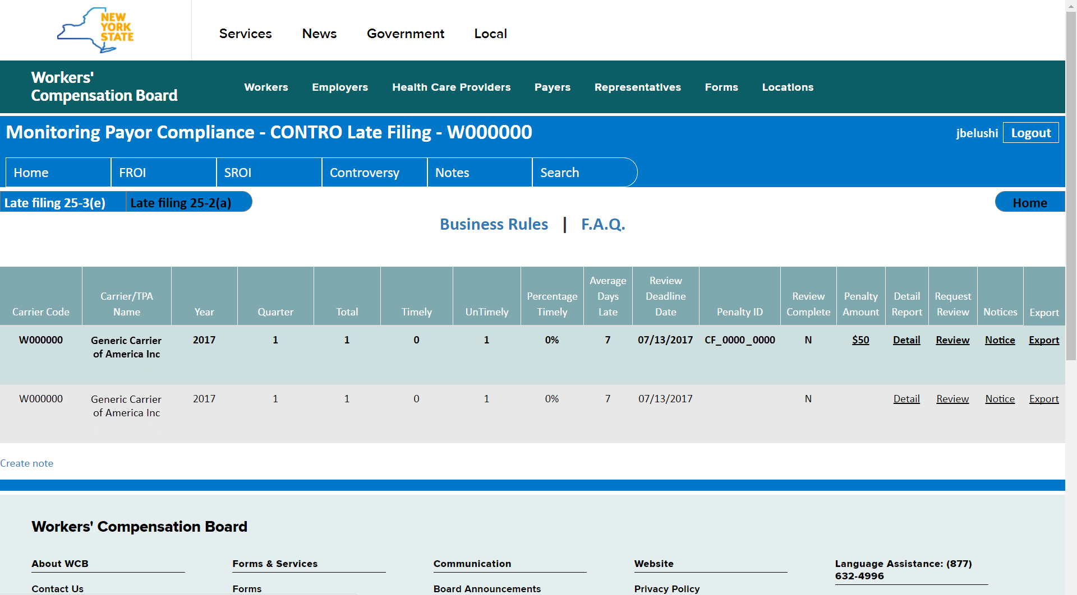
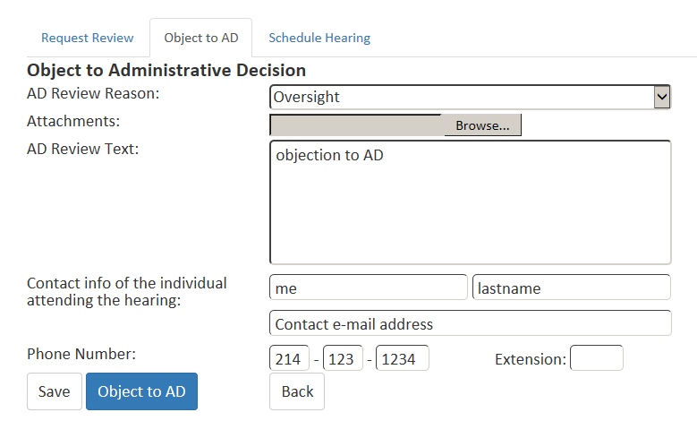
Controversy Report

Slide 31
For Questions or More Information:
Denise Hughes, Monitoring Program Manager Monitoring@wcb.ny.gov
Visit Our Website: wcb.ny.gov/content/main/Monitoring/Overview.jsp

